Slide 1





Statistics and Machine Learning with R
A Crash Course
Ting-Yat Wong IRTG 2150 PhD Candidate funded by DFG
Department of Psychiatry, Psychotherapy & Psychosomatics, RWTH Aachen University, Germany
Brain and Behavior Lab, Department of Psychiatry, University of Pennsylvania, Philadelphia, USA
tywong.one@gmail.com
kamione

Slide 2
Outline of Today’s Workshop
Why should we learn programming and R?
Introduction to R and the Data Model
Why should we should care about big data?
Introduction to machine learning
80% for the first two parts; 20% for the last two parts; with exercises
P.2
Notes:
It is hard to balance the practical issues and theoretical concerns in a short period
I will spend most of the time on introduction to R

Slide 3
Outline of Today’s Workshop
Why should we learn programming and R?
Introduction to R and the Data Model
Why should we should care about big data?
Introduction to machine learning
P.3

Slide 4
Importance of Data Analytic Skills
The ability to take data — to be able to understand it, to process it, to extract value from it, to visualize it, to communicate it — that’s going to be a hugely important skill in the next decades, not only at the professional level but even at the educational level for elementary school kids, for high school kids, for college kids. Because now we really do have essentially free and ubiquitous data. So the complimentary scarce factor is the ability to understand that data and extract value from it.
Hal Varian
Google’s Chief Economist
P.4

Slide 5

Why Programming (1)?
Reproducibility
P.5

Slide 6

Why Programming (2)?
Automation
P.6
Notes:
reusable

Slide 7

Why Programming (3)?
Communication
P.7

Slide 8
Why R?
Open source
Community support
Scripting programming language
Highly flexible
Highly extensible
Big-data-ready environment
Available on macOS, winOS, and Linux
Other languages: Python, C++, etc.
P.8
Notes:
You can build your own packages or use packages developed by others
To achieve the goals I just descript, here we come to R

Slide 9
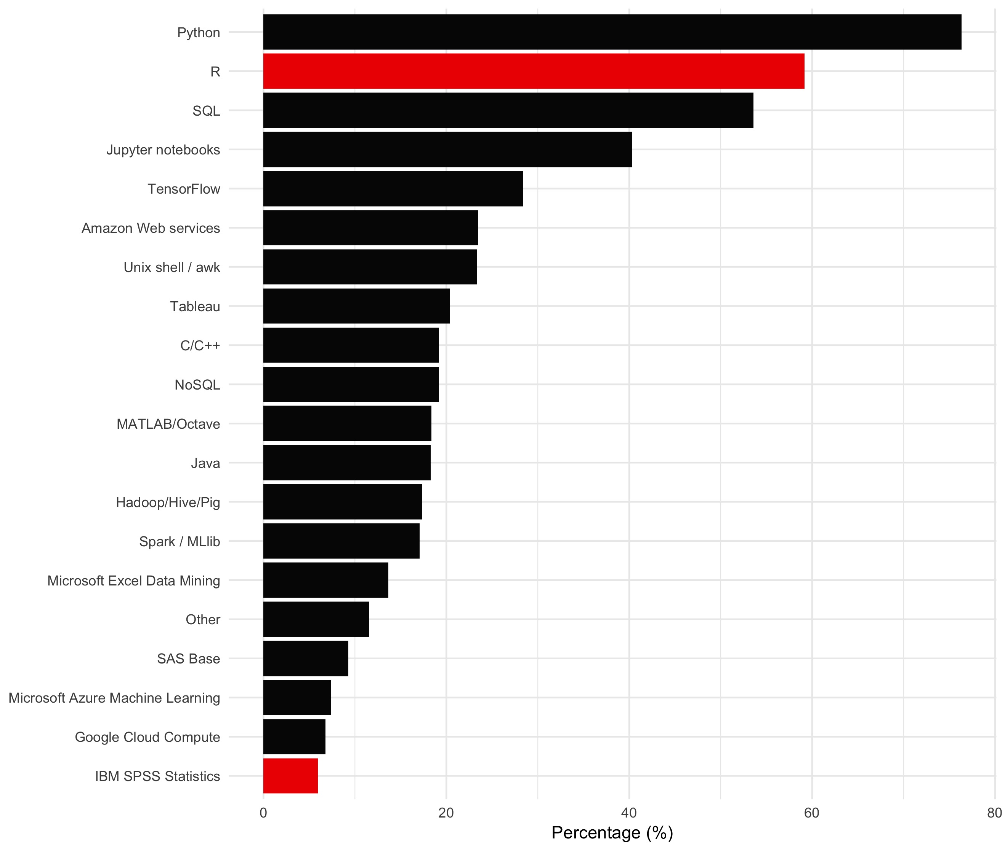
Data Scientists’ Tools
#2 R
#20 SPSS
N = 7955
P.9
Data obtained from www.kaggle.com
Notes:
Kaggle is a platform for predictive modelling and analytics competitions in which statisticians and data miners compete to produce the best models for predicting and describing the datasets uploaded by companies and users.

Slide 10
Outline of Today’s Workshop
Why should we learn programming and R?
Introduction to R and the Data Model
Why should we should care about big data?
Introduction to machine learning
P.10

Slide 11
Where Should We Start (1)?
R : http://cran.r-project.org/
R-Studio: http://www.rstudio.com/
R-Studio
R is not an application; it is a script programing language
IDE (interactive development environment)
Free and open source
P.11
Notes:
Take five minutes to download

Slide 12
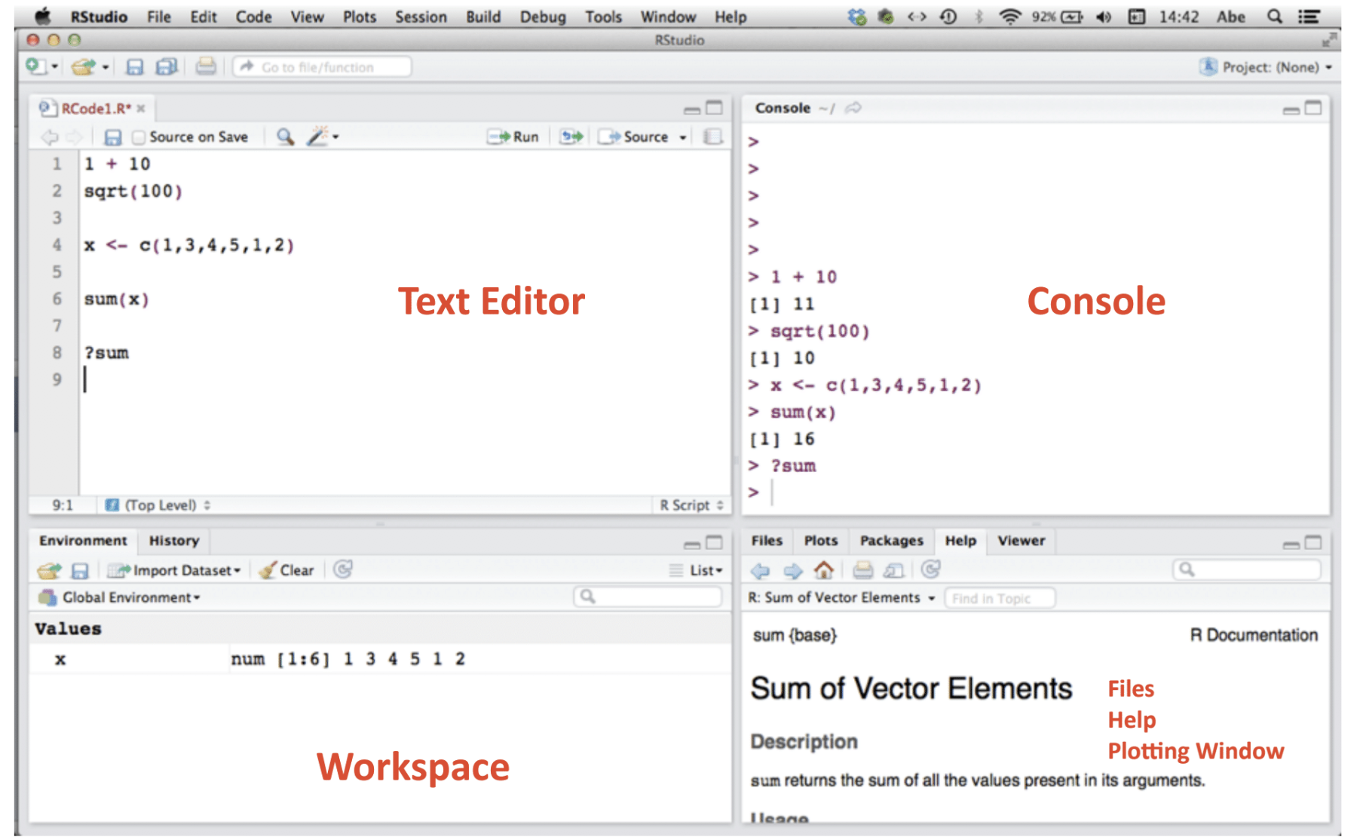
R-Studio Interface
P.12

Slide 13
R Basics: Operations
R as a calculator
# simple operations
14 + 3
10 / 12
3 * 18
3 ^ 3
# more complicated operations:
log(36)
sqrt(39204)
P.13

Slide 14
R Basics: Logical Statements
== equality
!= inequality
> greater than
>= greater than or equal to
< less than
<= less than or equal to
& AND
| OR
! NOT
50 == 50 + 1 # what is the output?
P.14

Slide 15
R Basics: Objects
R is a object-oriented programming language
Basically two types of objects:
DATA is used for information storage
FUNCTIONS act on the data
For example
my.height <- 177 # “<–” is assignment operator
my.weight <- 72
bmi(my.height, my.weight)
P.15

Slide 16
R Basics: Data
Vector (same type)
List (different types)
Matrix (row and column attributes)
Data Frame (table)
names <- c("Peter", "John", "Mary", "Kate") # strings
IQ.scores <- c(100, 125, 143, 165) # numeric
names.IQ <- list(names, IQ.scores)
X <- matrix(IQ.scores, nrow = 4, ncol =1)
df <- data.frame(names, IQ.scores)
P.16

Slide 17
R Basics: Functions
Functions written by others
User defined functions
Writing your own function:
name <- function(arg_1, arg_2, …) {expression}
greeting <- function() {
print("Hello World!")
}
greeting()
P.17

Slide 18
Exercise 1
Basic Level
Create a function that will calculate BMI
Create a function that will print the sum and product of 2 integers
A Bit Advanced Level
Create a function that given a vector will print by screen the mean and the standard deviation, it will optionally also print the median (Hints: you can assign a logical argument in the function)
P.18

Slide 19
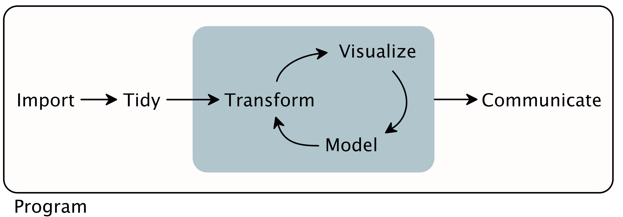
The Data Model
Reference: R for Data Science
P.19

Slide 20
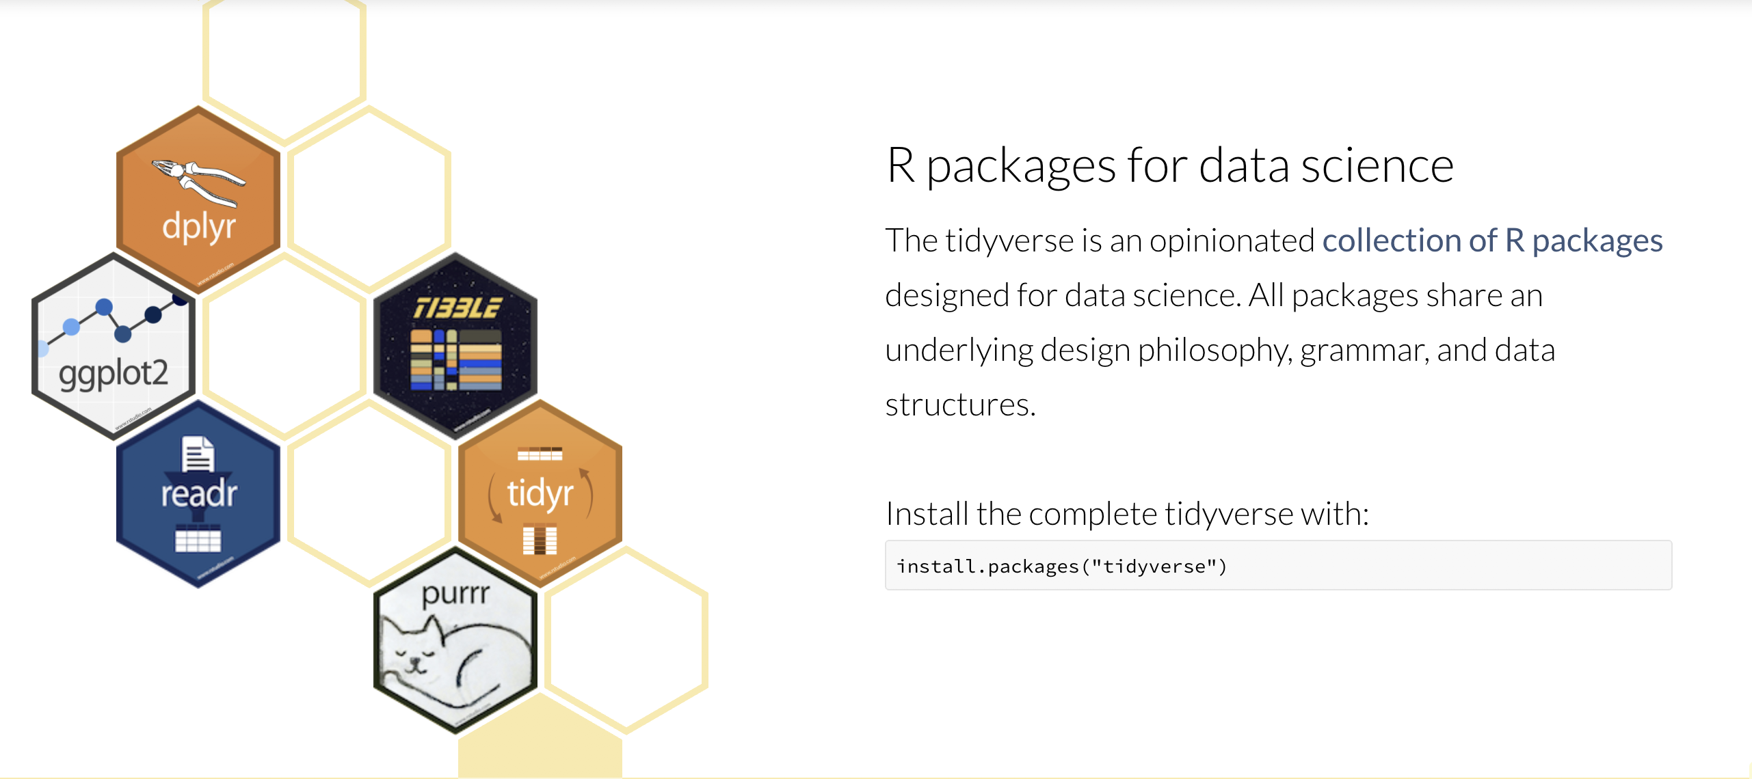
Where Should We Start (2)?
P.4

Slide 21
Import (1)
# required packages
library(tidyverse)
# set your working directory
setwd("your_working_directory/your_folder")
# read files
# read_csv() for common or read_csv2() for semicolon
gapminder <- read_csv("https://goo.gl/enujMy")
# also support other format
P.21

Slide 22
Import (2)
# show the data table in R-Studio
View(gapminder) # probably too much
# showing part of your data table
head(gapminder) # showing first 5 rows by default
head(gapminder, 15) # showing first 15 rows
tail(gapminder) # showing last 5 rows
names(gapminder) # getting the variable names
P.22

Slide 23
Tidy
Dealing with “NA” missing data
# a vector containing missing data
age <- c(32, 19, NA, 64)
mean(age)
# how to deal with it?
mean(age, na.rm = TRUE)
P.23

Slide 24
Transformation
# select data in 2007
gapminder_2007 <- gapminder %>% filter(year == 2007)
# select data from Asia
gapminder_asia <- gapminder %>% filter(country == "Asia")
# select countries that have a population larger than
# 10000000000
gapminder_mega <- gapminder %>% filter(pop > 1000000000)
P.24

Slide 25
Visualization (1)
Why is data visualization important?
Because of the way the human brain processes information, using charts or graphs to visualize large amounts of complex data is easier than poring over spreadsheets or reports. Data visualization is a quick, easy way to convey concepts in a universal manner – and you can experiment with different scenarios by making slight adjustments.
P.25

Slide 26
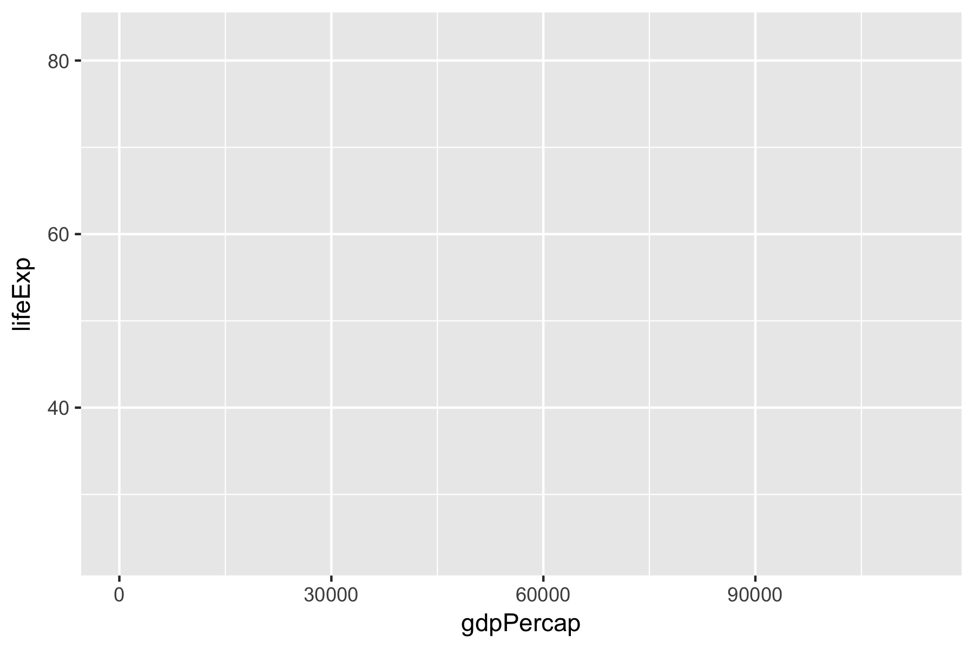
Visualization (2)
# frame of your figure
ggplot(gapminder, aes(x = gdpPercap, y = lifeExp))
P.26

Slide 27
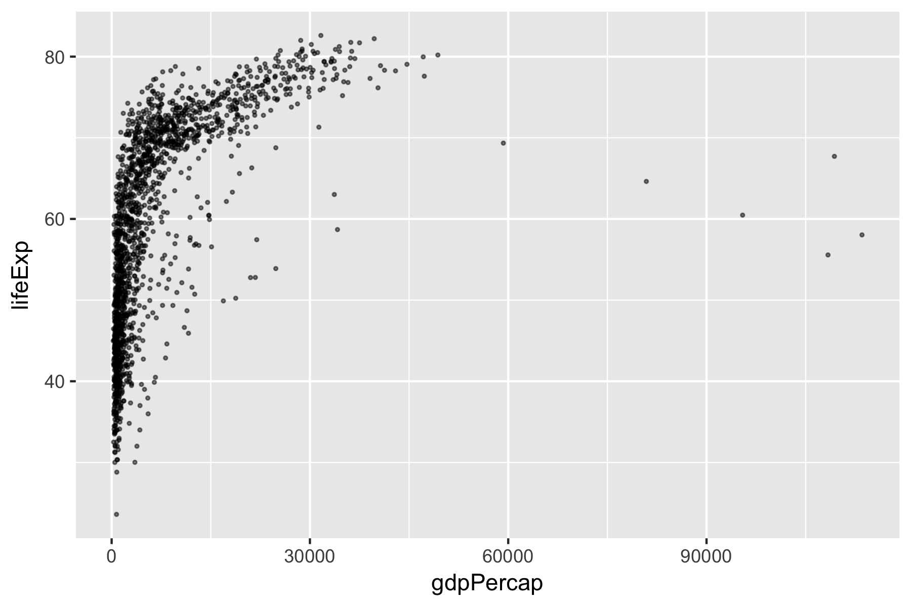
Visualization (2)
# add points
ggplot(gapminder, aes(x = gdpPercap, y = lifeExp)) +
geom_point(alpha = 0.5, size = 0.5)
P.27

Slide 28
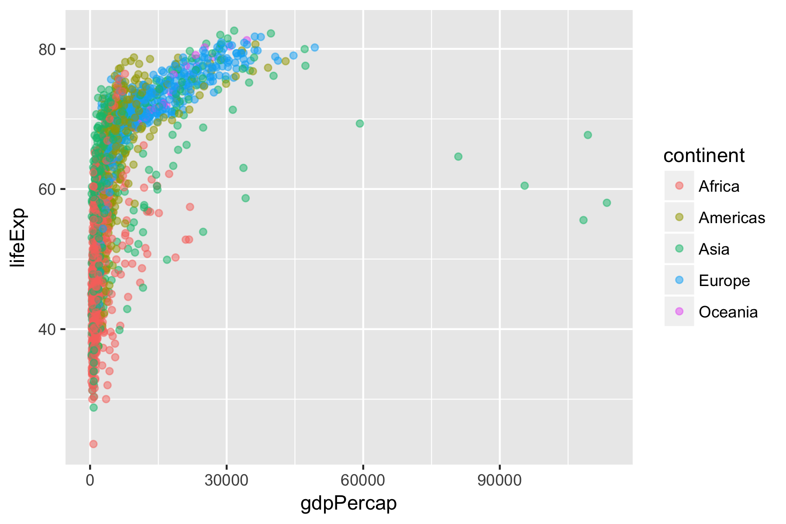
Visualization (3)
# add color about the continent
ggplot(gapminder, aes(x = gdpPercap, y = lifeExp, color = continent)) + geom_point(alpha = 0.5, size = 0.5)
P.28

Slide 29
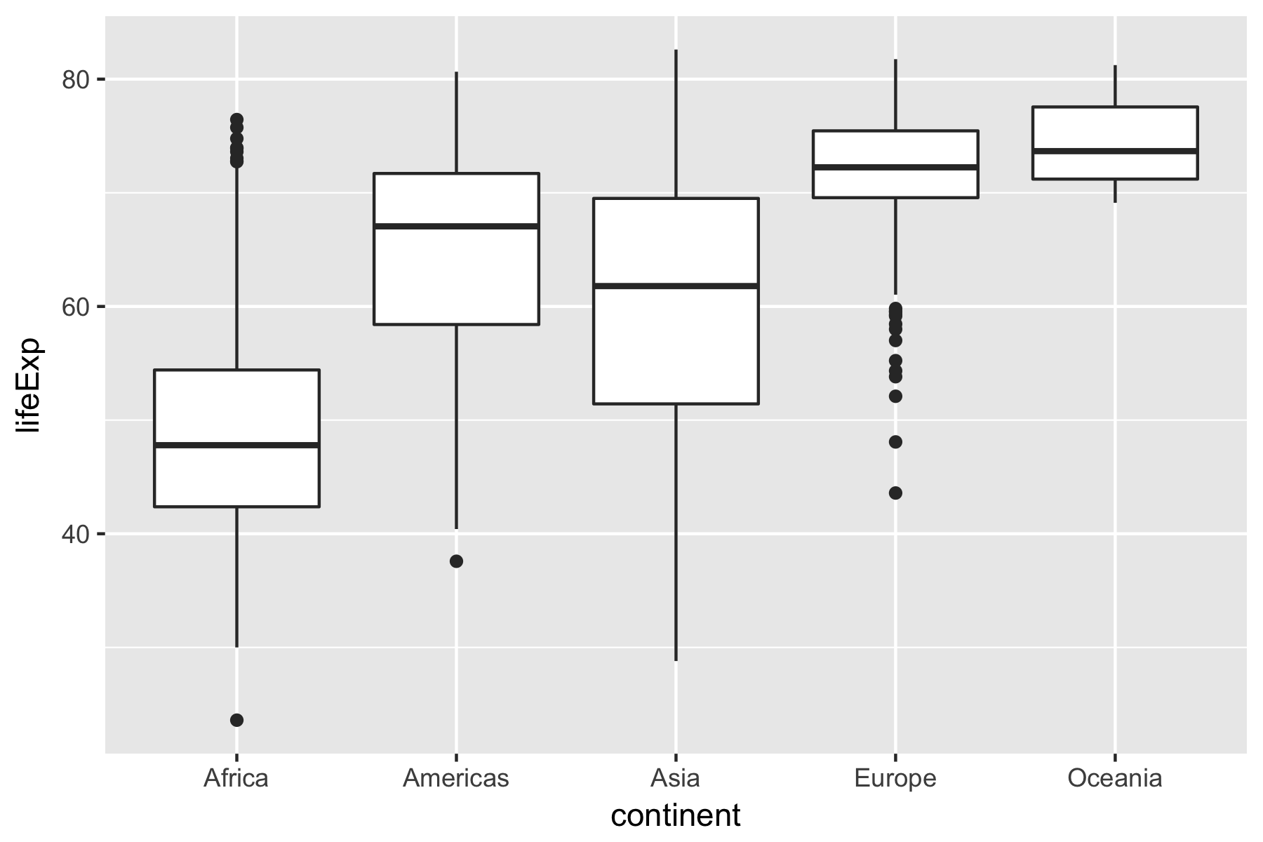
Visualization (4)
# boxplot
ggplot(gapminder, aes(x = continent, y = lifeExp)) +
geom_boxplot()
P.29

Slide 30
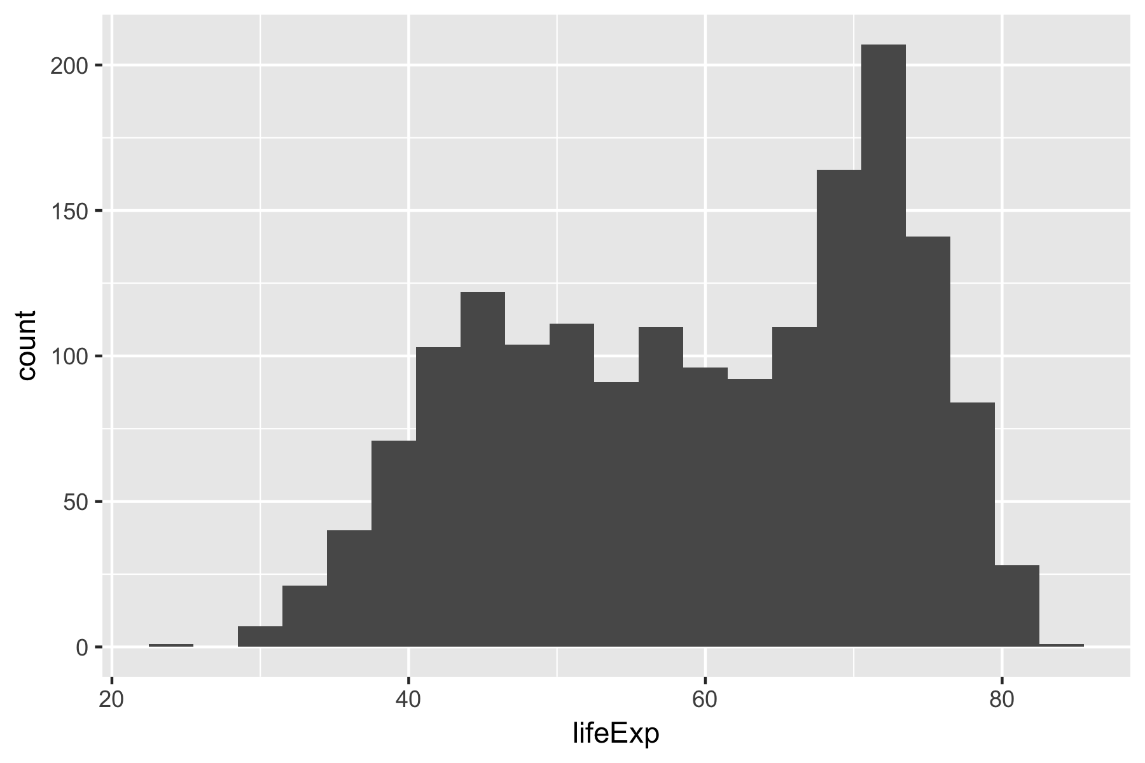
Visualization (5)
# histogram
ggplot(gapminder, aes(x = lifeExp)) +
geom_histogram(binwidth = 3)
P.30

Slide 31
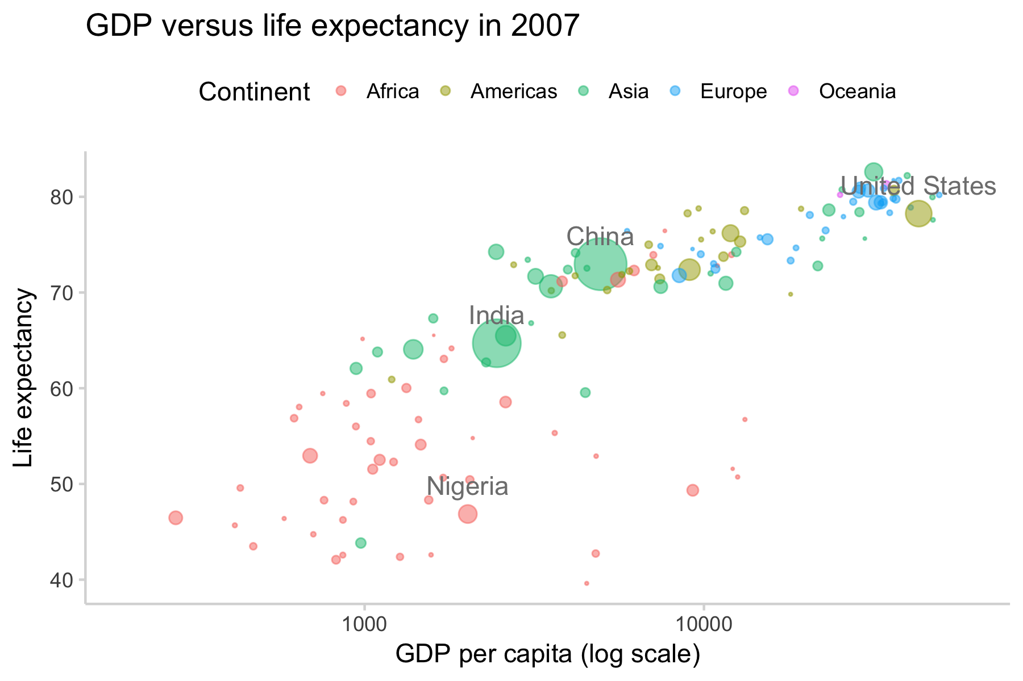
Challenge: Make a plot like this
P.31

Slide 32
Analysis (1)
Descriptive Stats
# overview of the dataset
summary(gapminder)
# overview of the dataset of each continent
by(gapminder, INDICES = gapminder$continent, summary)
# check numbers of countries
unique(gapminder$country)
length(unique(gapminder$country))
P.32

Slide 33
Analysis (2)
Simple Statistics
# Pearson’s correlation
cor(gapminder$lifeExp, gapminder$gdpPercap)
# Welch’s two sample t test
gapminder_subset <- subset(gapminder, continent == c("Europe", "Asia"))
t.test(lifeExp ~ continent, gapminder_subset)
# Paired sample t test
gapminder_subset <- subset(gapminder, year == c(2002, 2007))
gapminder_subset$year <- as.factor(gapminder_subset$year)
t.test(lifeExp ~ year, gapminder_subset, paired = TRUE)
P.33

Slide 34
Analysis (3)
General Lineal Modeling
# regression model
mod <- lm(lifeExp ~ pop + gdpPercap + year, data = gapminder)
# model summary
summary(mod)
Exercise 2
Are life expectancies in US higher than that in China?
Can you build a regression model that predict Asian’s life expectancies? And try to interpret the results
P.34

Slide 35
Communication
Writing styles, e.g.
  Google’s R style guide
  https://google.github.io/styleguide/Rguide.xml
Comments
rMarkdown
P.35

Slide 36
Outline of Today’s Workshop
Why should we learn programming and R?
Introduction to R and the Data Model
Why should we should care about big data?
Introduction to machine learning
P.36

Slide 37
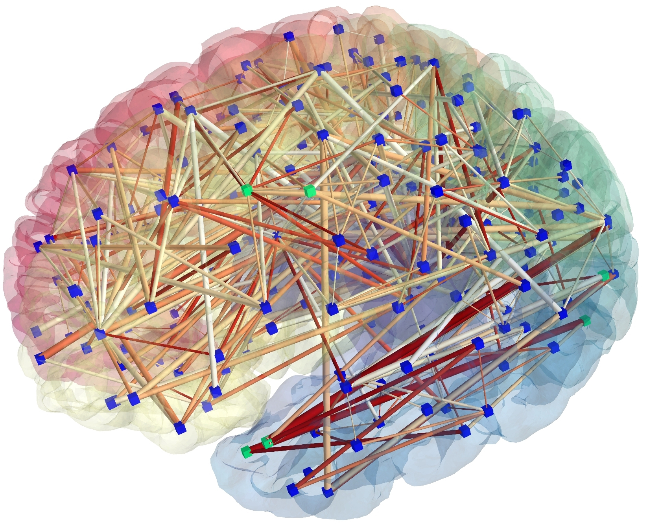
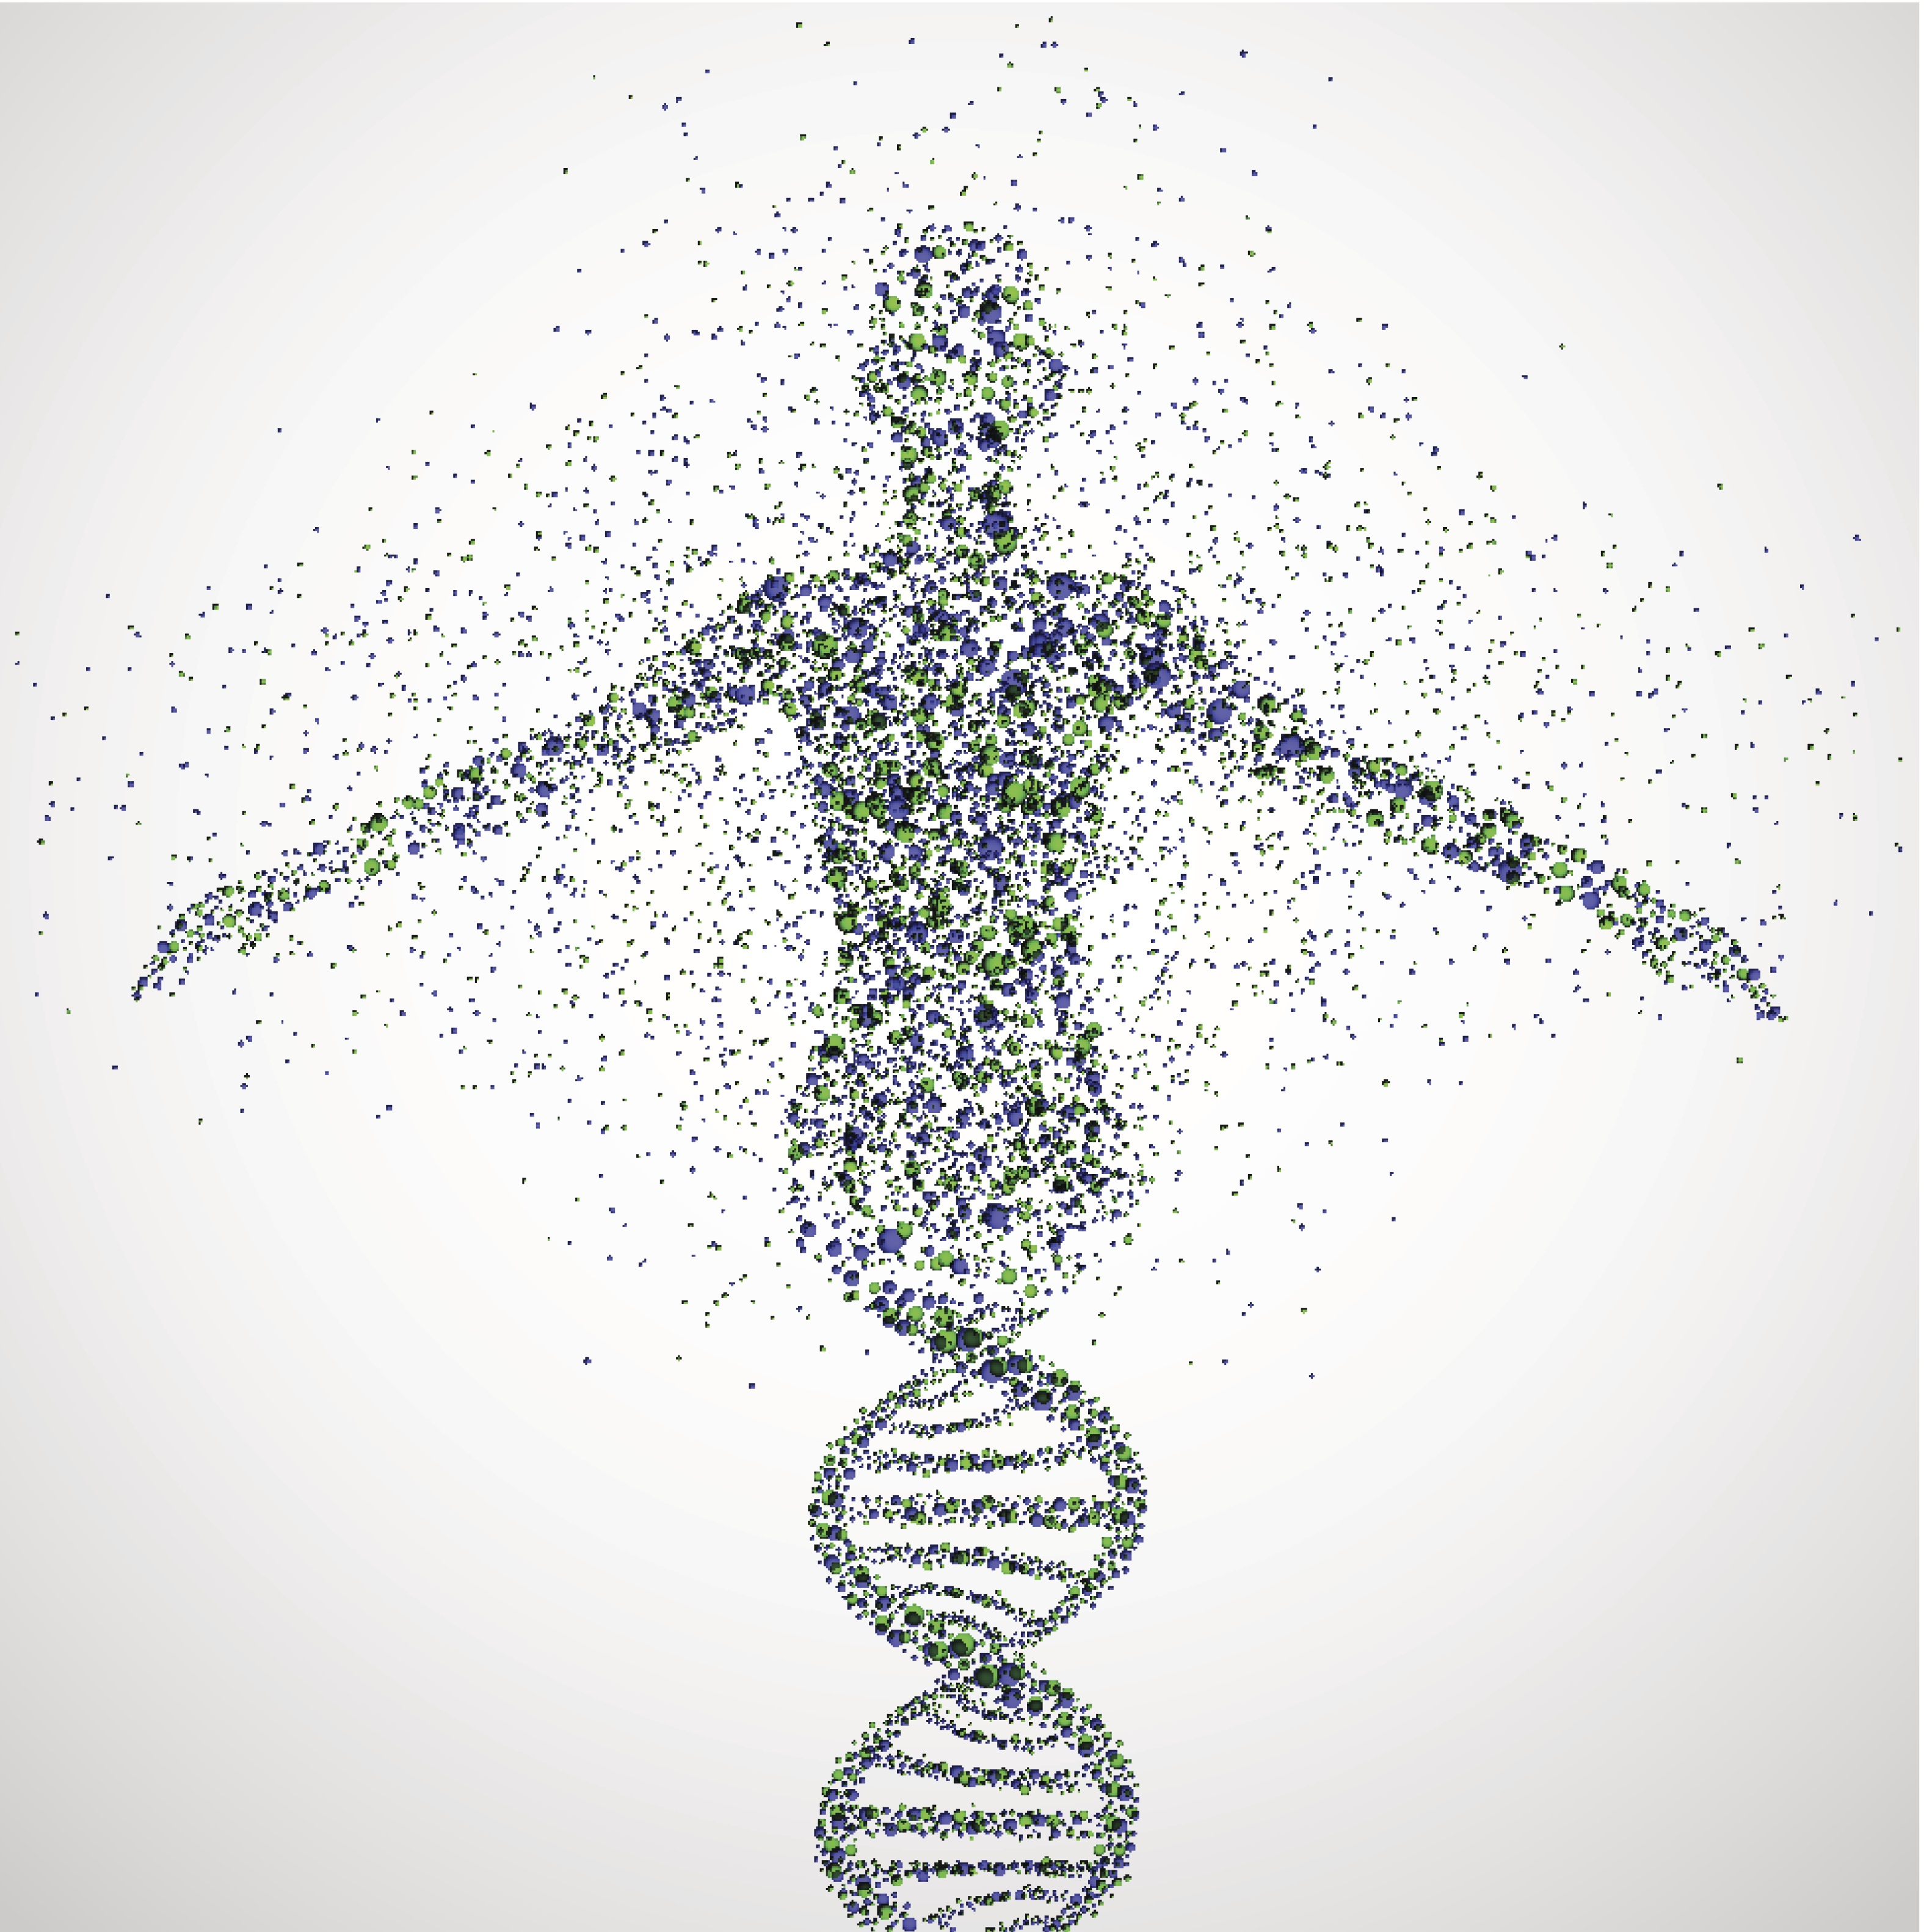
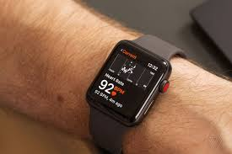

In a Big Data Era
Human Brain
Human Genome
Social Network
Daily Geo and Physiological Data
P.37

Slide 38
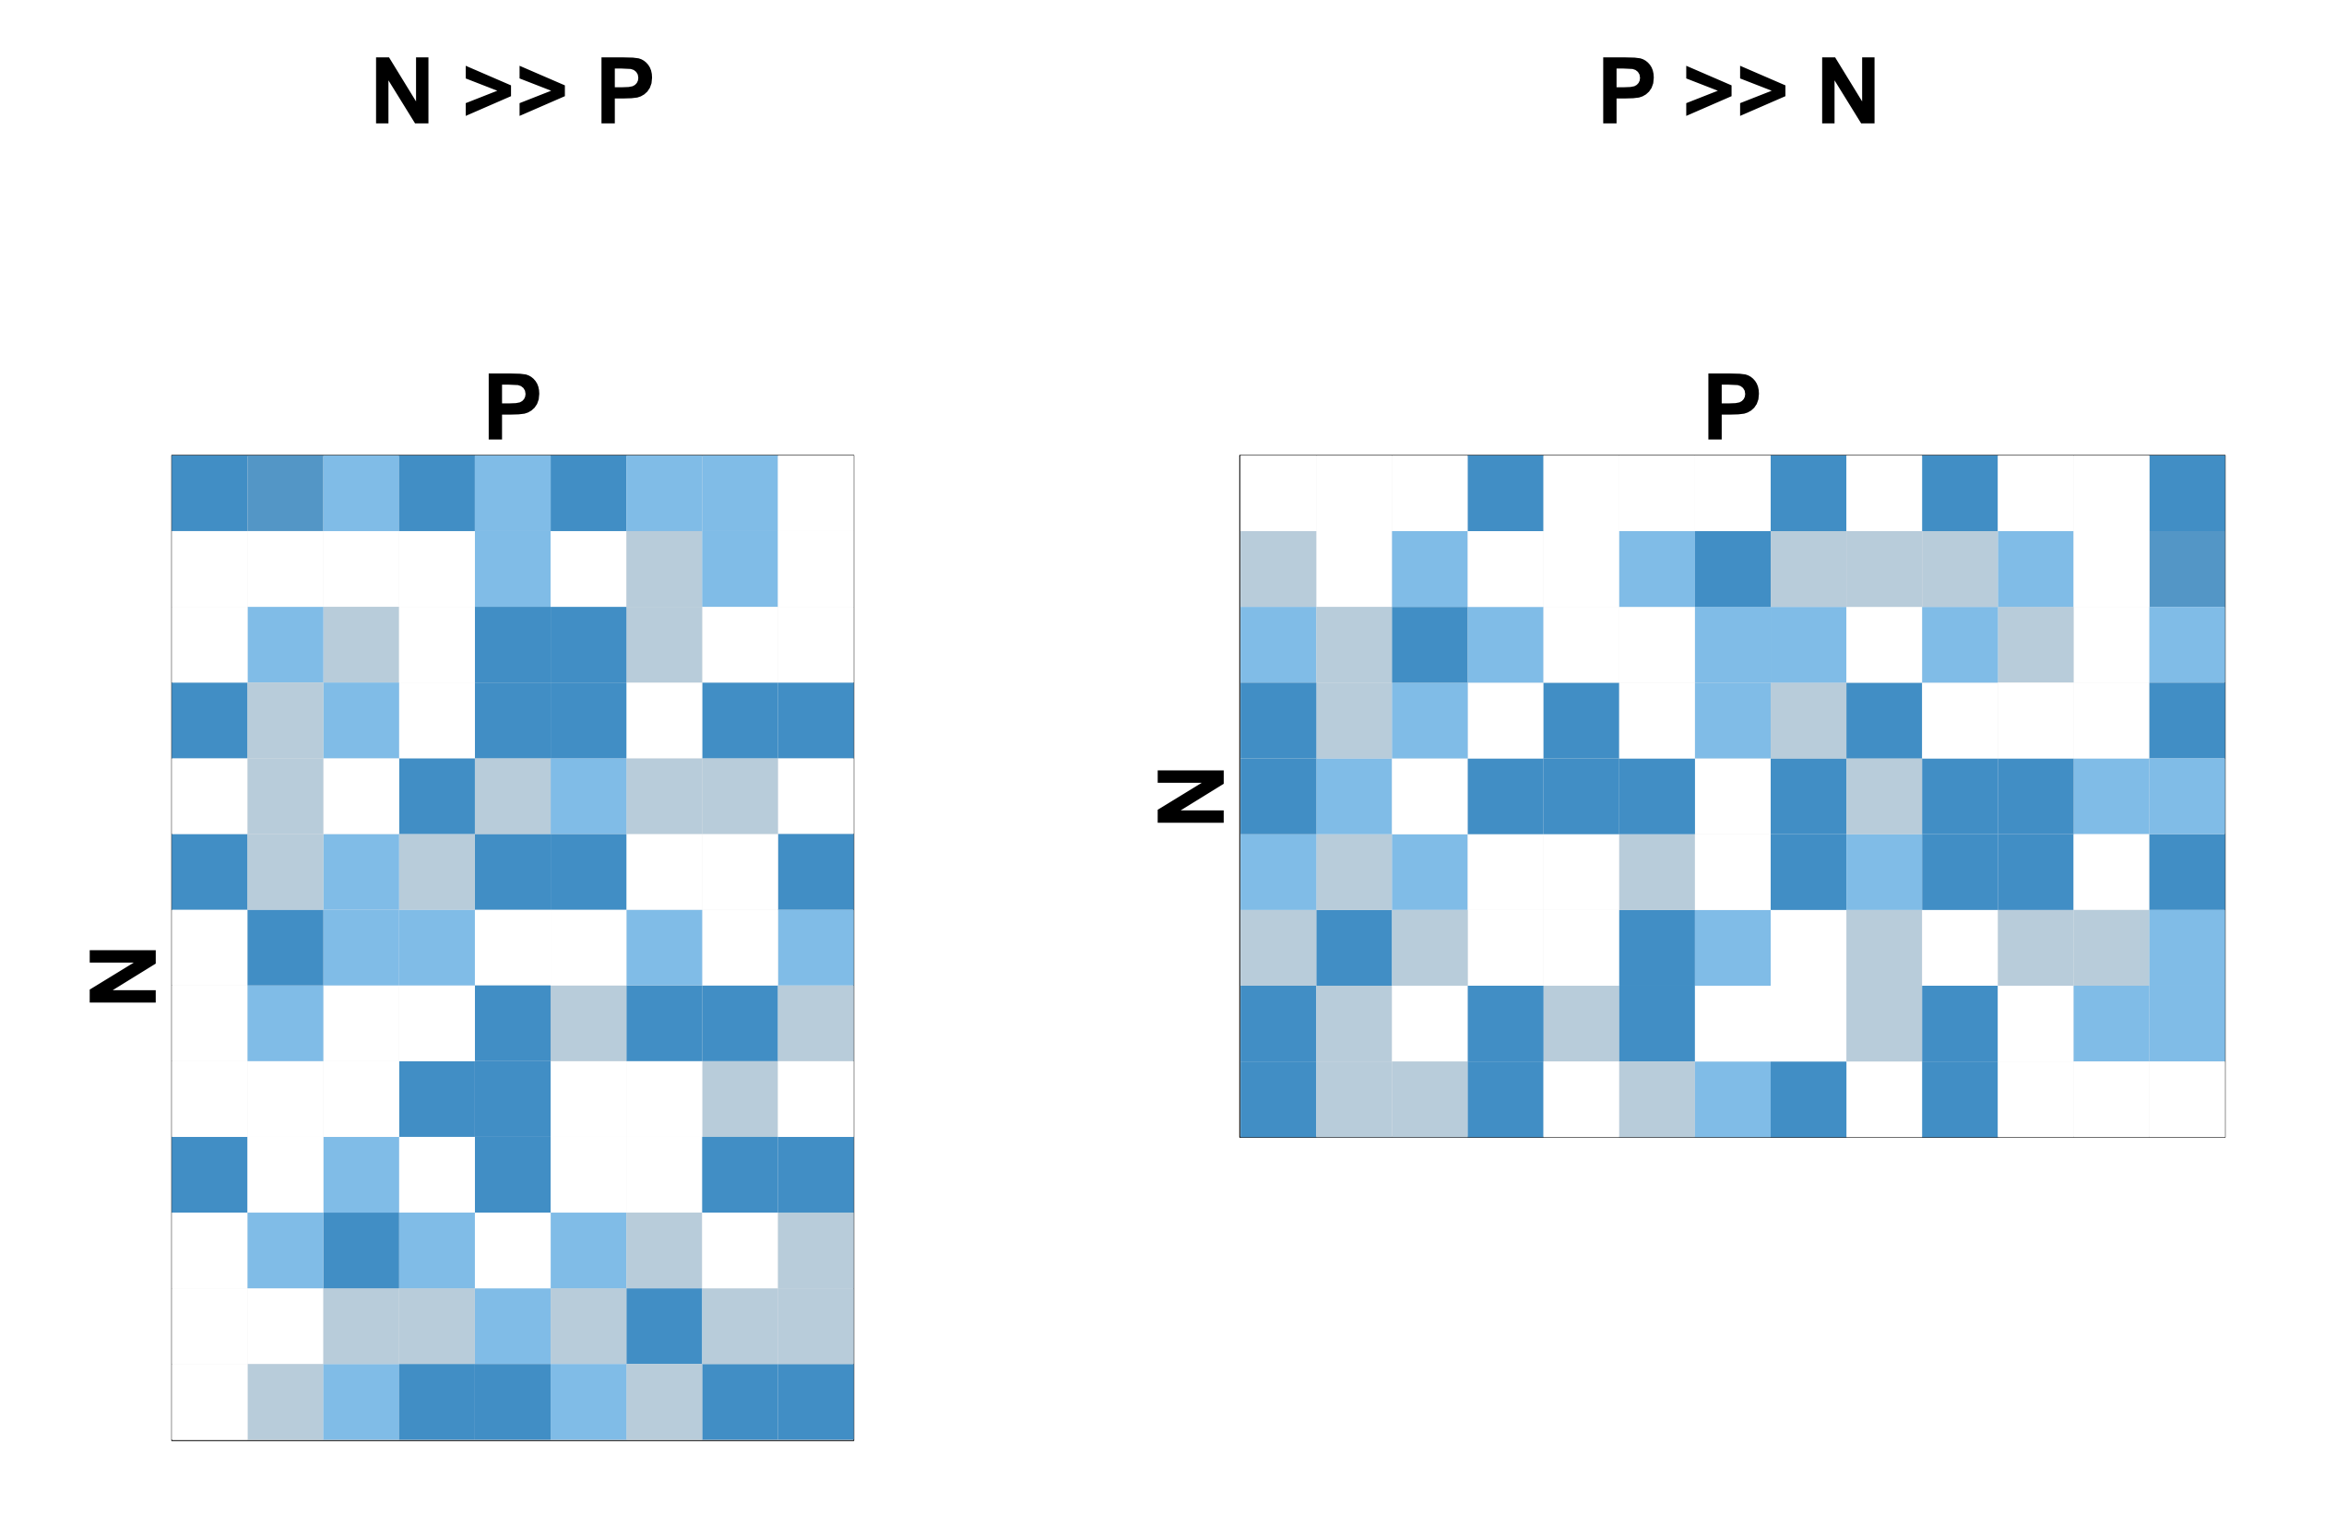
We Are Getting More and More “Wide Data”
P.38

Slide 39
Outline of Today’s Workshop
Why should we learn programming and R?
Introduction to R and the Data Model
Why should we should care about big data?
Introduction to machine learning
P.39

Slide 40
What is Machine Learning?
Construct or use algorithms that learn from data
More information will learn to higher performance
Learn from experience (data)
P.40
Notes:
Not explicitly program what you want to do

Slide 41
Common ML Problems (1)
Classification
Classification involves identifying the class (i.e., category) that a particular instance or observation belongs to, based on its features. Classification is typically a supervised learning task: the classes are specified prior to the training of the classifier.
P.41
Notes:
Overfitting occurs when a statistical model describes random error or noise instead of underlying relationship.

Slide 42
Common ML Problems (2)
Regression
Regression analyses in data mining are essentially the same as regression analyses used in non-big data settings. In machine learning contexts, regression analysis aims to identify the set of feature variables that have informative relationships with the target variable. The goal is to build a model that can be used to predict the outcome of new data samples
P.42
Notes:
Overfitting occurs when a statistical model describes random error or noise instead of underlying relationship.

Slide 43
Common ML Problems (3)
Clustering
Cluster analysis uses similarities and differences between samples to find hidden patterns and structures in the data
P.43
Notes:
Overfitting occurs when a statistical model describes random error or noise instead of underlying relationship.

Slide 44
Common ML Problems (4)
Supervised Learning
Classification
Develop predictive modal based on both input and output data
Regression
Supervised Learning
Clustering
Group and interpret data based only on input data
P.44

Slide 45
What we want to know?
Inference | Prediction
Inference creates a mathematical model of the data- generation process to formalize understanding or test a hypothesis about how the system behaves. | Prediction aims at forecasting unobserved outcomes or future behavior, such as whether a mouse with a given gene expression pattern has a disease.
Bzdok et al. (2018) Nature Methods
P.45
Notes:
Overfitting occurs when a statistical model describes random error or noise instead of underlying relationship.

Slide 46
Big Data Hubris!?
Supplement, not a replacement, of traditional data collection and analysis
Simply having access to a lot of data makes the use of rigorous methods unimportant? NO
    Big data isn’t necessarily better data
P.46

Slide 47
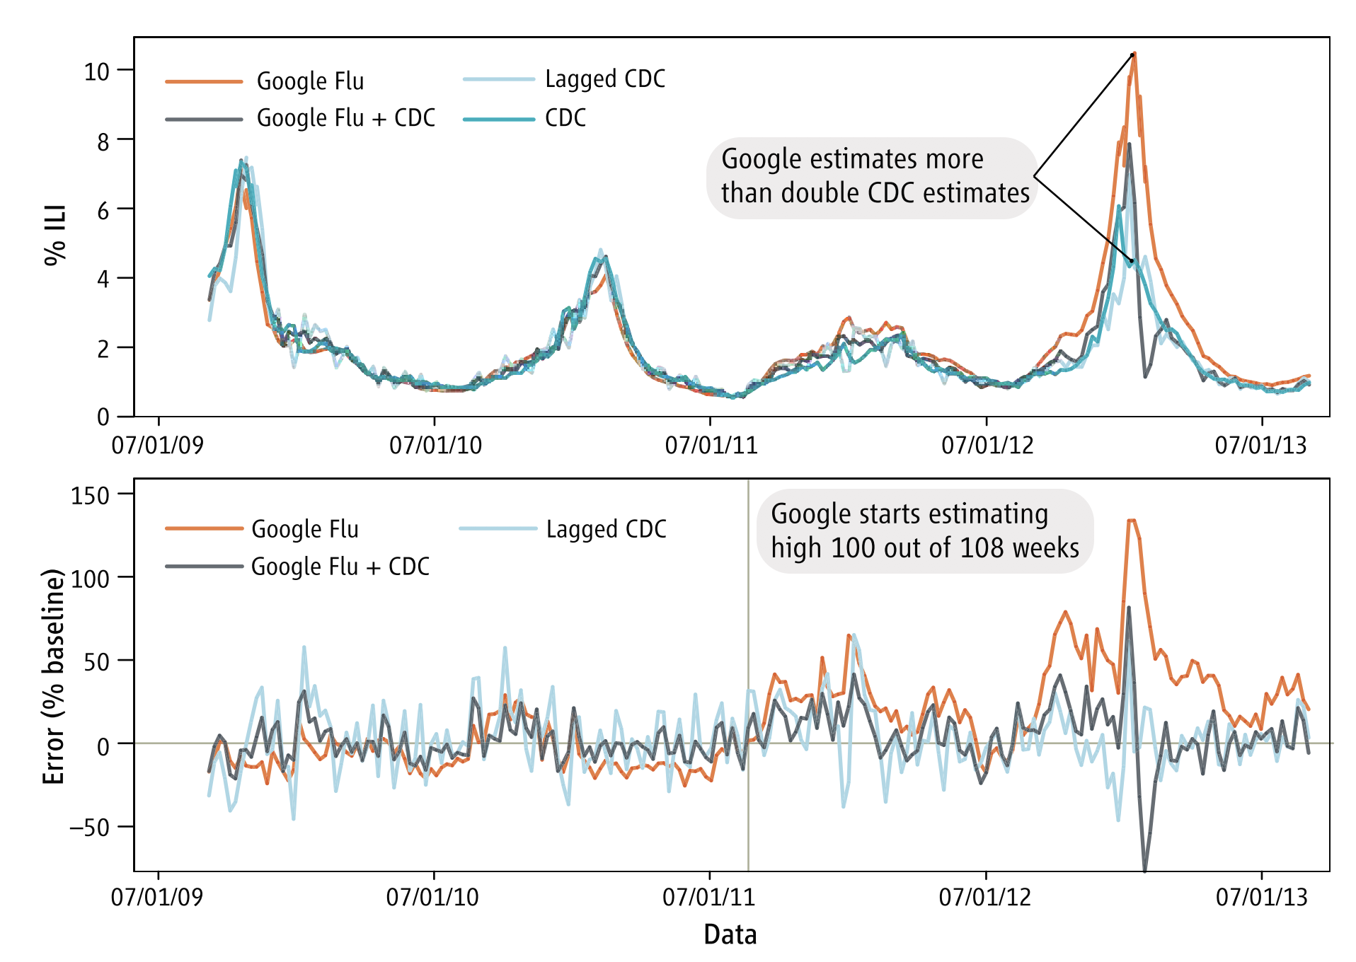
Problematic Machine Learning
A case of Google Flu Trends (GTF)
P.47
Notes:
Overfitting occurs when a statistical model describes random error or noise instead of underlying relationship.

Slide 48
Take Home Messages and Outlook
Open science practice
R programming provides a good environment for reproducible research
Learning R can get you ready for the big data challenge
Big data is not necessarily better data
Personally, I favor big data for generating novel hypothesis and experiments for hypothesis confirmation
P.48

Slide 49
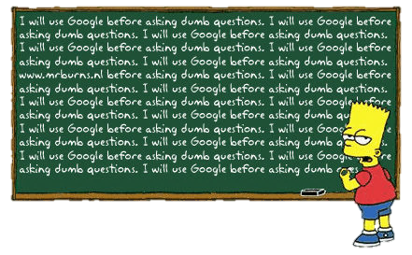
Resources
CRAN, Stack Overflow, R-Blogger, r4stats, etc.
P.49

Slide 50






Thank you for your attention!
Acknowledgements:
Penn Brain Behavior Laboratory
Supervisor
Thomas Nickl-Jockschat
RWTH Aachen & UIowa
Supervisor
Ruben C. Gur
UPenn
Tyler Moore
Kosha Ruparel
Adon Rosen
and
other members in the lab
ENIGMA Consortium, Schizophrenia Working Group
http://enigma.ini.usc.edu
Deutsche Forschungsgemeinschaft

