Slide 1
Applying brain stimulation techniques to study human brain functions
Kenneth Yuen, PhD
Neuroimaging Center (NIC),
University Medical Center Mainz

Slide 2
Prerequisits
Theoretical model of your own research question
A good understanding on the theoretical underpinnings of brain stimulation techniques
Good knowledge on neuroanatomy
Knowledge on experimental psychology (study design), neurophysiology (results to be expected)

Slide 3
Prerequisits
Theoretical model of your own research question
A good understanding on the theoretical underpinnings of brain stimulation techniques
Good knowledge on neuroanatomy
Knowledge on experimental psychology (study design), neurophysiology (results to be expected)

Slide 4
TMS vs tES
Spatial resolution
Temporal effectiveness
Setup time
Aversive effects
Equipment cost
Portability
Limit of stimulations

Slide 5
Goal of stimulation?
To trigger AP/interrupt regional neuronal processing?
To enhance/inhibit a perceptual/cognitive process?
To test the role of neural oscillations at a certain frequency
band?
To probe neural connections?
To test a stochastic model of brain function?
To double dissociate the role of two/more brain regions?

Slide 6
Goal of stimulation?
To trigger AP/interrupt regional neuronal processing? SP
To enhance/inhibit a perceptual/cognitive process?
To test the role of neural oscillations at a certain frequency
band?
To probe neural connections?
To test a stochastic model of brain function?
To double dissociate the role of two/more brain regions?

Slide 7
Goal of stimulation?
To trigger AP/interrupt regional neuronal processing? SP, DP
To enhance/inhibit a perceptual/cognitive process?
To test the role of neural oscillations at a certain frequency
band?
To probe neural connections?
To test a stochastic model of brain function?
To double dissociate the role of two/more brain regions?

Slide 8
Goal of stimulation?
To trigger AP/interrupt regional neuronal processing? SP, DP
To enhance/inhibit a perceptual/cognitive process? rTMS
To test the role of neural oscillations at a certain frequency
band?
To probe neural connections?
To test a stochastic model of brain function?
To double dissociate the role of two/more brain regions?

Slide 9
Goal of stimulation?
To trigger AP/interrupt regional neuronal processing? SP, DP
To enhance/inhibit a perceptual/cognitive process? rTMS, tDCS
To test the role of neural oscillations at a certain frequency
band?
To probe neural connections?
To test a stochastic model of brain function?
To double dissociate the role of two/more brain regions?

Slide 10
Goal of stimulation?
To trigger AP/interrupt regional neuronal processing? SP, DP
To enhance/inhibit a perceptual/cognitive process? rTMS, tDCS
To test the role of neural oscillations at a certain frequency
band? tACS
To probe neural connections?
To test a stochastic model of brain function?
To double dissociate the role of two/more brain regions?

Slide 11
Goal of stimulation?
To trigger AP/interrupt regional neuronal processing? SP, DP
To enhance/inhibit a perceptual/cognitive process? rTMS, tDCS
To test the role of neural oscillations at a certain frequency
band? tACS
To probe neural connections? All
To test a stochastic model of brain function?
To double dissociate the role of two/more brain regions?

Slide 12
Goal of stimulation?
To trigger AP/interrupt regional neuronal processing? SP, DP
To enhance/inhibit a perceptual/cognitive process? rTMS, tDCS
To test the role of neural oscillations at a certain frequency
band? tACS
To probe neural connections? All
To test a stochastic model of brain function? tRNS
To double dissociate the role of two/more brain regions?

Slide 13
Goal of stimulation?
To trigger AP/interrupt regional neuronal processing? SP, DP
To enhance/inhibit a perceptual/cognitive process? rTMS, tDCS
To test the role of neural oscillations at a certain frequency
band? tACS
To probe neural connections? All
To test a stochastic model of brain function? tRNS
To double dissociate the role of two/more brain regions? All

Slide 14
Stimulation parameters
TMS: online/offline?
Online: single pulse/double pulse/burst, stimulation timing, stimulation frequency
Offline: inhibition/excitation, duration of stimulation
tES: Electrode arrangement/reference electrode/duration
tDCS: current strength
tACS: frequency of AC, phase lag
tRNS: level of noise
Control site/sham stimulation

Slide 15
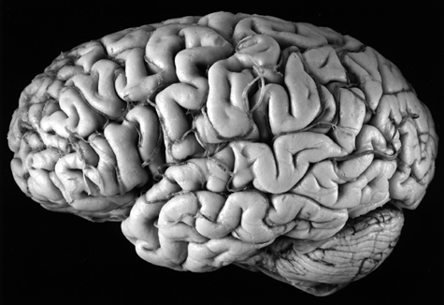
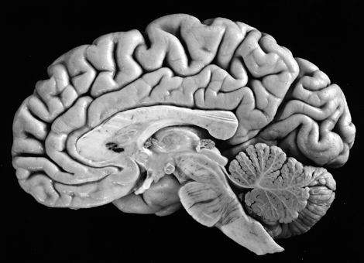
Stimulation site
Cortical site
Is afferent site possible?
Safety issues

Slide 16
Is neuronavigation available?
Neuronavigation
In vivo mapping of individual’s brain structure with the scalp
High resolution MRI image required (e.g. MPRAGE)

Slide 17
Simulating electric field for tES
Head model created based on high resolution MRI image
Simulate current flow with different electrode placement

Slide 18
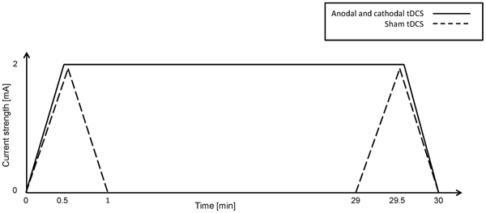
Sham stimulation
Is double blind, placebo controlled design possible?
Sham TMS: rotate coil 90°/Sham TMS coil
Sham tES

Slide 19
Advanced brain stimulation design
EEG-TMS
EEG-tDCS/EEG-tACS
fMRI-TMS
fMRI-tDCS
Model based TMS/tES

Slide 20
Case Demonstration 1
It is known that attention function can be divided into subcomponents of alerting, orienting, & executive control. Using the attention network test, functional indices of these three subcomponents can be calculated.
A researcher hypothesized that the alerting component is subserved by right posterior parietal cortex, orienting component subserved by frontal eye field, & executive control subserved by DLPFC.
Can you design a brain stimulation experiment to test the above hypothesis?

Slide 21
Case Demonstration 2
It is known that cells in the rat hippocampus showed activities of “replay” as a means of memory consolidation roughly 5mins after they learnt to navigate in a maze. The degree of “replay” is correlated to subsequent testing of memory strength.
A researcher want to test if the same happens in human, and he planned to use brain stimulation to disrupt such memory consolidation
How can we design a brain stimulation experiment to serve this purpose?

Slide 22
Case Demonstration 3
It is often assumed that the parietal association area (e.g. IPL) is mainly responsible for multisensory integration whereas the frontal association area (e.g. DLPFC) is responsible for higher order abstraction of information
Can you design a brain stimulation experiment to test this assumption?

Slide 23
Hands on session

